Slide 1
With a little help of VMS’ Friends
(season 4)
Gérard Calliet
pia-sofer

Slide 2
2013 : bad year
I was here to help going on
With some funny lessons about leverage and investment
It is always important to keep smiling

Slide 3
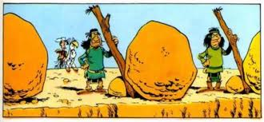
Physics for the business
What do you see here ?
Oracle and HP waiting for their customers ?

Slide 4
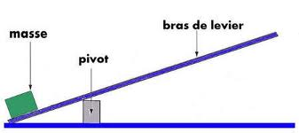
Physics for business
A Lever

Slide 5
Physics for business
Everyone in business love LEVERS
But do not confuse :
  A point of support (has to be fixed)
  The leverage action (can grow and grow)
Otherwise…

Slide 6
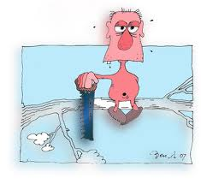
Another aspect of physics for business

Slide 7

The Program Has Changed
Before July 31st, the question was: We have fundamental reasons to organize an ordered retreat; how do we proceed?
After July 31st, the question became: On what foundations should our future be affirmed and organized?
Or: Why did we survive?
And then: On what foundations should we base ourselves?

Slide 8
Physics for the business
What do you see here behind ?

Slide 9

VSI

Slide 10
Physics for business
We have got the investment
We must take the opportunity

Slide 11
Keys for success
The community must involve itself
VSI success is in our hands
We have to rebuild communities
To relink between communities
Specificaly in Europ from where there was the strongest reactions

Slide 12
European initiatives
Internet sites (France www.hp-interex.fr)
Surveys (needs, informations,…) published very soon
Exchange of informations, talks to the press
Organization of a major European event in spring when VSI has concrete things to show

Slide 13
Who to connect with?
Usual suspects
Loyal ISVs (Oracle…)
Loyal VMS Consultants
Loyal VMS ambassadors
Loyal users clubs
Loyal Open Source Port communities
Loyal collegues in your country, in Europe, in the world
I (loyal) have theories about all that: http://www.pia-sofer.fr/IMG/pptx/s126_-_vaticuum.pptx

Slide 14
Whith whom to connect?
Newbies ☺
susan.skonetski@vmssoftware.com
www.vmssoftware.com
facebook page : vmssoftware
facebook page : openvms friends
…

Slide 15
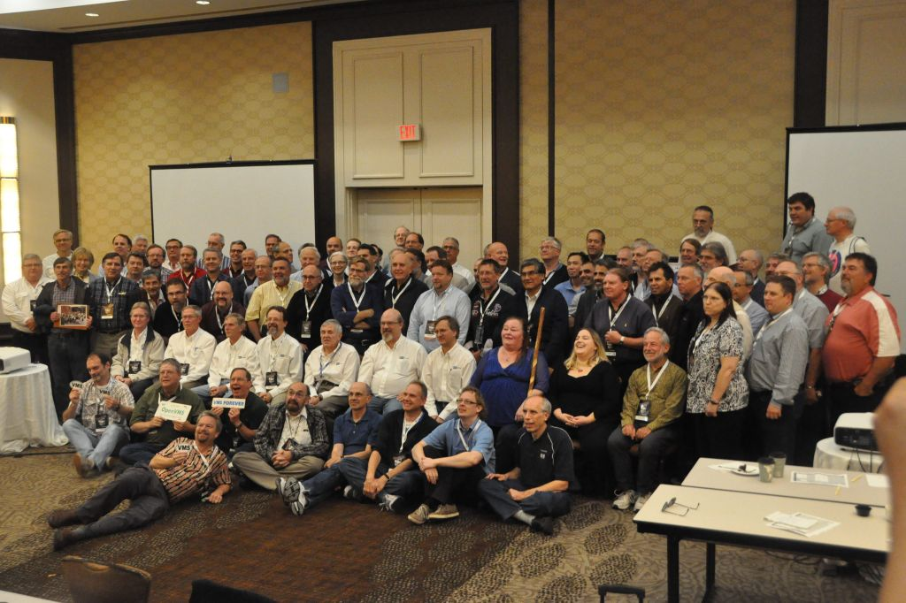
Snapshot

